Slide 1
File System

Slide 2
Introduction to File System
A file system is a fundamental component of computer operating systems, organizing and managing data on storage devices.
It establishes a hierarchical structure with directories for systematic file storage.
Metadata, such as file size and creation date, is associated with each file for management and security purposes.
Access control mechanisms regulate user permissions to safeguard against unauthorized access.
As technology advances, file systems evolve to accommodate larger storage capacities and changing user needs.

Slide 3



File creation
File creation in a Unix/Linux environment is commonly performed using commands in the terminal.
Here are some essential commands related to file creation:
Using touch: touch filename.txt
Using vi filename

Slide 4

cat command:
creates a file ex: $ cat>filename
cat also used to display the contents of the file
Eg: cat filename display the contents of the filename.
cat < filename displays the contents of the filename using input redirection operator.
cat >filename creates a file using output redirection.
cat >> filename performs append operation to a file.

Slide 5
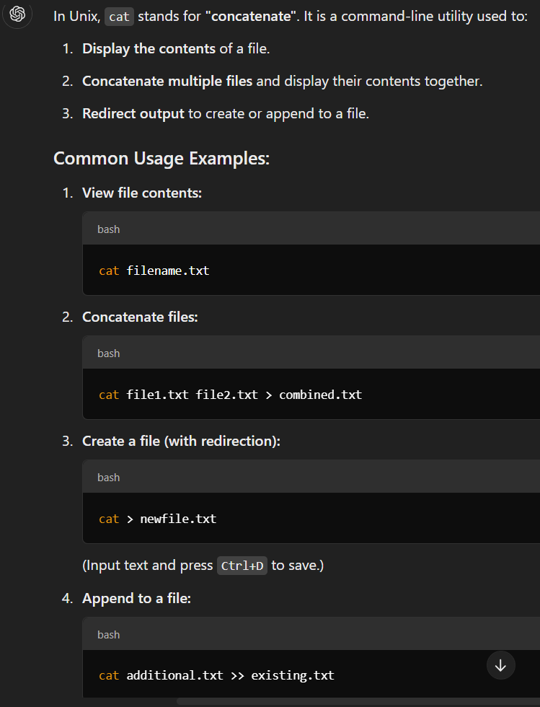
Also, cat < filename .txt

Slide 6
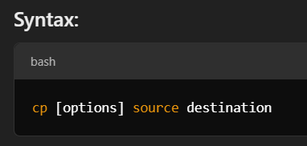
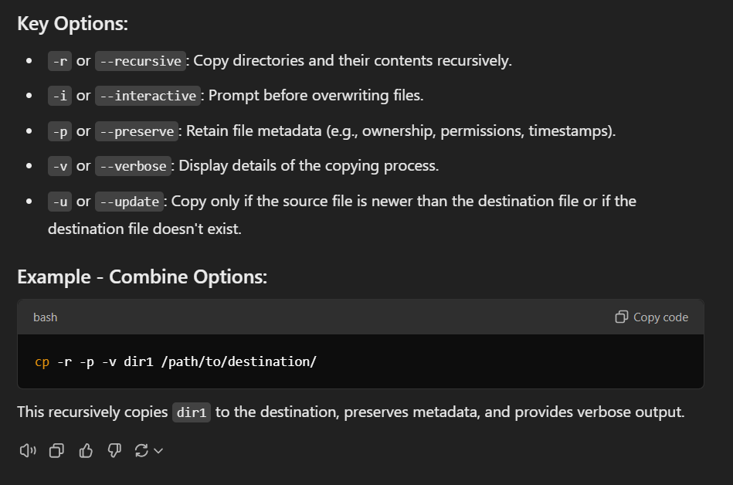

cp command
cp - Copy Files
Syntax:
cp [-i] file1 new_file
Copy a file
cp [-i] file [file...] dest_dir
Copy files to a directory
cp -r [-i] dir [dir...] dest_dir
Copy directories
Example:
cp file1 d1
copies file1 to d1 directory
cp file2 file3
create a copy of file2 as file3 in the same directory

Slide 7
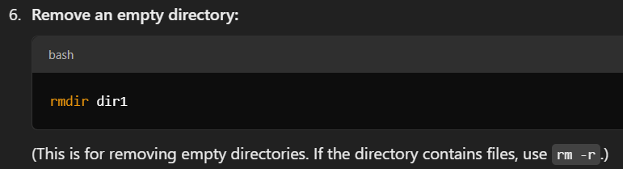
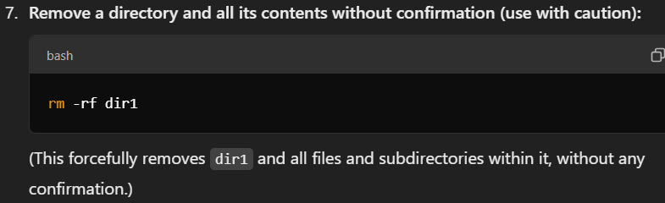
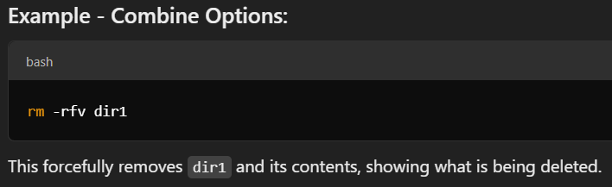
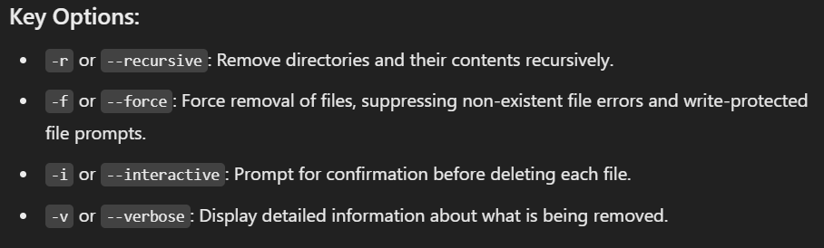






rm - Remove Files
Syntax:
rm [-if] filename [filename...]
Remove files.
rm -r[if] dirname [filename...]
Remove directories.
Examples:
rm f1
removes the file f1
rm –r d1
remove the directory.
Rm –rf f1

Slide 8
mv:
→ perform two functions.
1. Renames a file or directory.
2. Moves a group of files to different directory.
Syntax:
mv [-i] file new_file Rename a file
mv [-i] file [file...] dest_dir Move files to a directory
mv [-i] dir [dir...] dest_dir Rename or move directories

Slide 9
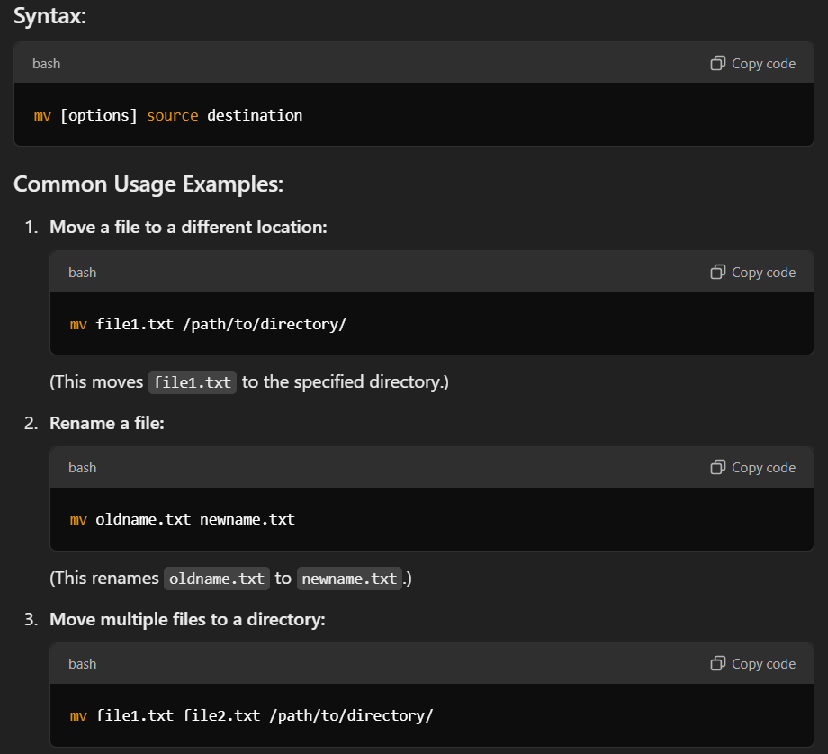
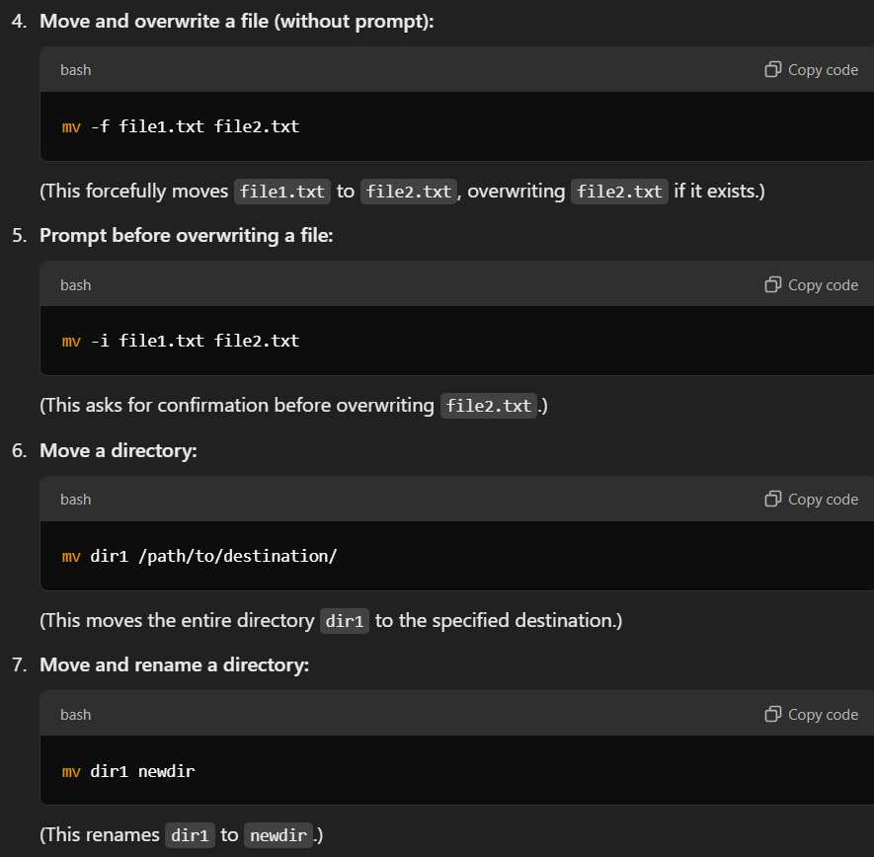



Slide 10
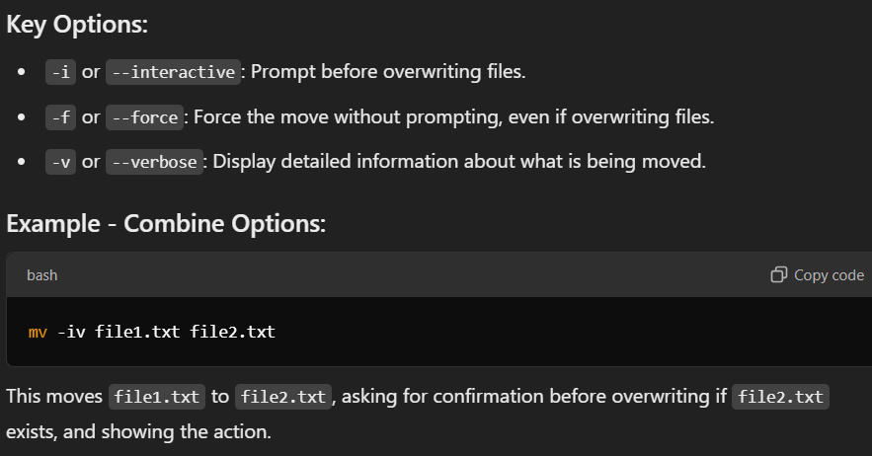



Slide 11
Managing Files more - Display the Contents of a File
Syntax:
more [filename]... Display files one screen at a time
Example:
$ more funfile
--funfile (20%)--
Q or q
Quit
Return
One more line
Space bar
One more page.

Slide 12
file :Knowing the File Types
$ file archive.zip
→ archive.zip :ZIP archive.
file correctly identifies the basic file types (regular , directory or devices).
file *
* to signify all files ,this is how files behave on this system having regular files of varying types:
file file1.txt file2.jpg
Types of multiple files

Slide 13
ls : Listing directories and files
(Numbers first,uppercase amd then lowercase).
Example:
ls perl
Perl:No such file or directory.
Options:
Output in Multiple Columns(-x)
When you have several files its better to display the filenames in multiple columns

Slide 14
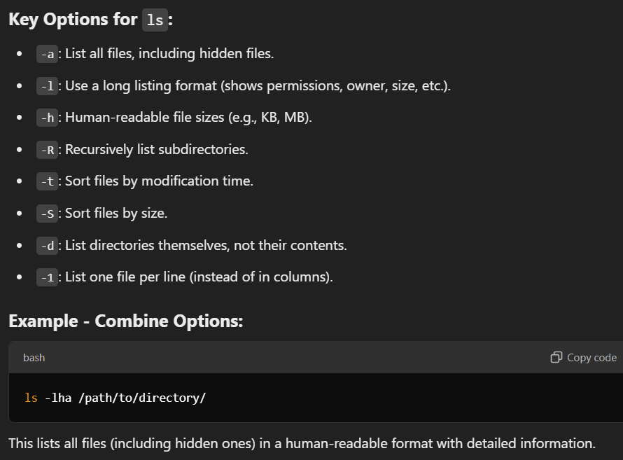


in a directory tree.

Slide 15

ls: command options
$ls –Fx :
These option outputs ls command to identify directories and executable files. Combining with x produces a multicolumn output.
Showing Hidden Files (-a) ls does’nt normally show all files in a directory .There are
certain hidden files (fienames begin with a dot)in every directory,especially
In the home directory that normally don’t show up in listing.
The –a option (all) lists all hidden files along with the other files.
The –d option of ls force ls to list the attributes of the directory,rather than its contents.
Eg $ ls –ld helpdir progs

Slide 16

ls command options
-x Multicolumnar output
-F
Marks executables with *
directories with /
symbolic links with @
-a Shows all filenames beginning with a dot including . and ..
-R recursive list
-r sorts filenames in reverse order
-t sorts filenames by last modification time
-u sorts filenames by last access times.
-i Displays inode Number

Slide 17

ls commands
Listing Directory contents In the last example ,you specified some ordinary
filenames to ls to have a selective listing
. ls -x helpdir progs
helpdir:
forms.odd graphics.odd reports.odd
progs:
array.pl name.pl
.) ls -xR (Recursive Listing) The recursive option lists all files and subdirectories
in a directory tree.

Slide 18


Managing Files wc command
The wc command counts the number of lines, words and bytes in a named file.
syntax:
wc [-c] [-l] [-w] filename
Options:
-c counts the number of bytes
-l counts lines
-w counts words
Example:
$wc testfile

Slide 19
pg command
In Unix, pg is a command-line utility used to view the contents of a file one screen at a time, similar to more. It allows you to scroll through the text, but it provides additional control over navigation and searching within the file.
Use the pg command to read the files named in the File parameter and writes them to standard output one screen at a time.
If you specify hyphen (-) as the File parameter or run the pg command without options, the pg command reads standard input.
Each screen is followed by a prompt.
Syntax
pg [-number] [-p string] [-cefnrs] [+line] [+/pattern/] [file...]

Slide 20
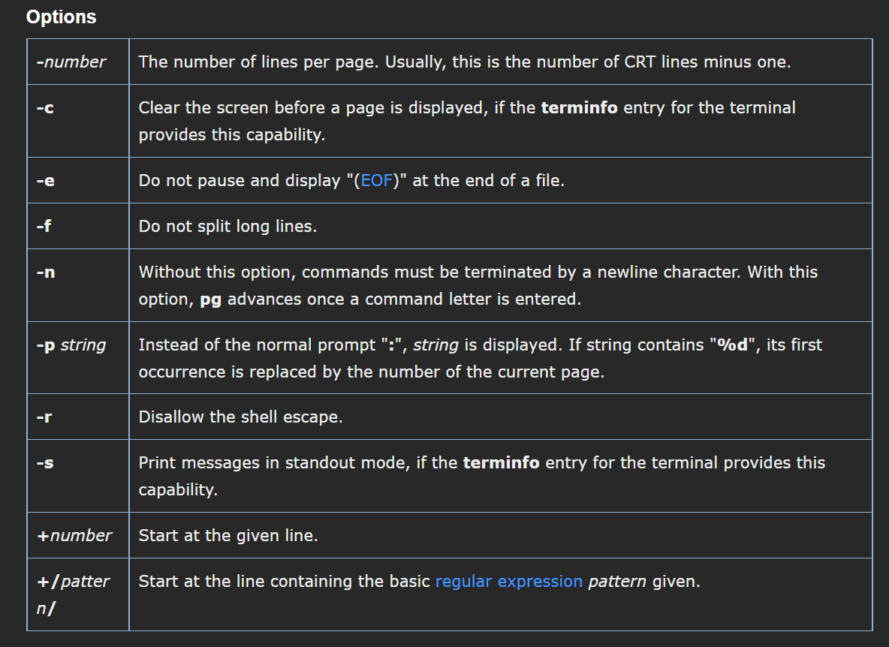
Contd…

Slide 21
Cmp → Comparing Two Files
whether two files are identical
There are three commands in the Unix system that can tell you that.
cmp chap01 chap02
chap01 chap02 differ: char 9,line 1.
The two files are compared byte by byte and the location of the first mismatch is echoed on the screen. cmp by default ,does not bother about possible subsequent mismatches.
The –l(list) option
gives a detailed list of the byte number and the differing bytes in octal for each character that differs in both files.

Slide 22
cmp :Comparing Two Files
cmp –l note1 note2
3 143 145
6 170 167
7 171 170
8 172 171
The above Eg shows four differences in the two files .
If two files are identical ,cmp displays no message ,but simply returns the prompt.
$ cmp chap01 chap02
$ _

Slide 23
Comm → What is Common
Suppose You have two lists of people and you are asked to find out the names available in one and not in the other,or even those common to both.
comm is the command you need for this work it requires two sorted files and lists the differing entries in different columns.
$cat file1 $cat file2
c.k.Shukla anil aggarwal
chanchal singhvi barun dasgupta
s.n.dasgupta c.k.shukla
sumit chakrobarty lalit chowdary
S.N. DASGUPTA

Slide 24
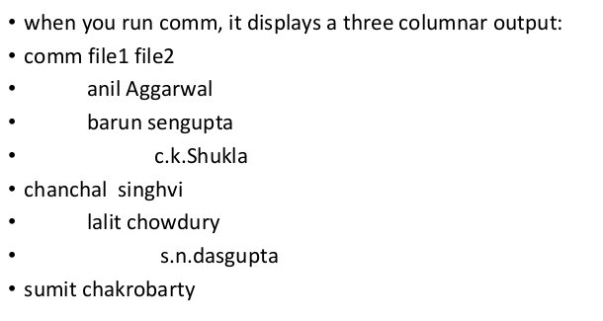

comm : What is common

Slide 25




Comm: What is common
The first column contains two lines unique to first file, and
The second column shows threelines unique to the second file.
The third column displays two files common(hence its name) to both files.
Options: -1,-2 or -3
single column output
To drop a particular column, simply use its column number as an option prefix .
comm -3 foo1 foo2
Selects lines not common to both files
comm -13 foo1 foo2
Selects lines present only in second file (i.e. not in first and not in common)

Slide 26
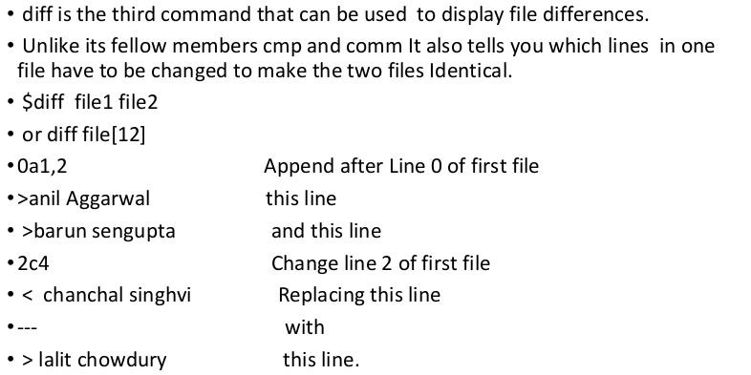
Diff command

Slide 27
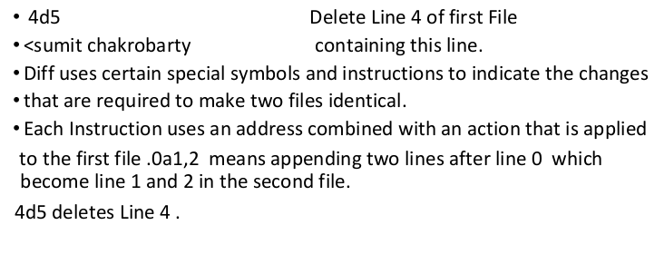
Diff Command

Slide 28
Compressing and Archiving Files
To conserve Disk space you’ll have to compress large and infrequently used files.A file can often be compressed to a fraction of its Original size.
Every Unix System comes with some or all of the following compression and decompression utilities.
compress and uncompress(.Z) (obsolete)
gzip and gunzip(.gz)
tar command for archival.
zip and unzip(.zip)

Slide 29
Compressing and Archiving Files
The Extension acquired by the compressed filename is shown in parenthesis.The degree of the compression that can be achieved depends on the type of file, its size and the compression program used.
We wont consider compress in this syllabus because it is superseded by other programs.
Apart from compressing, You’ll also require to group a set of files into a single file,called an archive. The tar and zip commands can pack an entire directory structure into an archive.
In the next section we’ll be discussing these compression and archival utilities.

Slide 30
Compression and Archival Files
We’ll start with gzip a very popular program,that works with one or more filenames.It provides the extension .gz to the compressed filename and removes the original file.
In the following example we run gzip on the file libc.html. We also note the file size ,both before and after compression using wc –c which counts characters.
$wc –c libc.html
3875302 libc.html
$gzip libc.html
$wc –c libc.html.gz
788096 libc.html.gz

Slide 31
Compress and Archive File
We can repeat same set of commands by using postscriptfile.
wc -c UserGuide.ps
372267 User_Guide.ps Before Compression
128341 User_Guide.ps.gz After compression
How much compression did we actually achieve for both files? Use the –l option with the compressed or orginal filenames as argument
$gzip –l libc.html.gz User_Guide.ps.gz
Compressed uncompr ratio uncompressed name
788096 3875302 79.6 libc.html
128341 372267 65.5 User_guide.ps
916437 4247569 78.4 (totals)

Slide 32
Uncompressing a gzipped File(-d)
To restore the original and uncompressed file ,You have two options.Use either gzip –d or gunzip with one or more filenames as arguments the .gz extension is optional yet again.
For Eg
gunzip libc.html.gz Recieves libc.html
gunzip libc.html.gz User_guide.ps.gz Works with multiple Files.
gzip -d libc.html Same __.gz assumed
.) You can now browse the files with their respective viewers.

Slide 33
Compressing a gzipped File(-d)
Recursive Compression (-r) You can descend a directory structure and compress all files found in sub directories. You need the –r option ,and the
arguments to gzip must comprise at least one directory.
gzip -r progs
This option can be used for decompression also. To decompress all files
In the directory you need to use gunzip –r progs or gzip –dr progs.
Writing to Terminal(-c)

Slide 34
Zip and Unzip : Compressing and Archiving
Zip command generally does’nt compress as much as gzip but it combines
the compressing function of gzip with the archival function of tar.
So instead of using two commands to compress a directory structure, you can use only one –zip. All the letters of the alphabet are available as it options but we’ll consider only few of them.
Eg $zip archive.zip libc.html User_Guide.ps
Recursive Behavior(-r) zip uses the –r option .It descends the directory tree structure in the same way tar does except that it also compresses files.

Slide 35
Zip and Unzip :Compresing and Archiving
$cd ~
$ zip -r sumit_home.zip . (Compresing and archiving home directory files)
Using unzip Files are restored with the unzip command which in its simplest
form uses the compressed filename as argument.
$unzip archive.zip .
But if the uncompressed file exists on disk, then unzip makes sure that it’s doing the right thing by seeking user confirmation.
replace libc.html ? [y]es, [n]o, [A]ll, [N]one, [r]ename:y
You can respond with y or n. You can also rename the file ( r ) to prevent overwriting or direct unzip to perform the decompression on the remaining Files non-Interactively.

Slide 36
Zip and Unzip :Compressing and Archiving
Viewing the Archive(-v) You can view the compressed archive with the -v option .The List shows both the compressed and uncompressed size of each file in the archive along with the percentage of compression achieved.
$unzip –v archive.zip
Archive: archive.zip

Slide 37
tar – Archival Program
For creating a disk archive that contains a group of files or an entire directory structure we need to use tar.
For this minimal use of tar we need to know these key options.
-c Creates an archive.
-x Extracts Files from archive.
-t Display files in archive
-f arch Name the archive arch
Only one of these key options can be used at a time. We’ll also learn to use gzip and gunzip to compress and decompress the archive created with tar.

Slide 38
Creating an Archive (-c)
To create an archive, we need to specify the name of the archive (with –f) the copy or write operation(-c) and the filename as arguments.
Eg of tar command
$ tar –cvf archive.tar libc.html User_Guide.ps
a libc.html 3785k
a User_Guide.ps 364k
By convention we use the .tar extension ,so you’ll remember to use the same tar command for extraction.

Slide 39
tar – Archival Program
Tar command also behaves recursively to back up one or more directories.
In the following example,tar fills the archive progs.tar with three directory structures.
tar -cvf progs.tar c_progs java_progs shell_scripts.
We’ll soon use the same tar command to extract files from this archive .
Let’s see how we can compress archive .
Using gzip with tar
If the created archive is very big ,you may like to compress it with gzip.
gzip archive.tar.
This creates a tar –gzipped file archive.tar.gz . This can be sent over the ftp
or Internet.

Slide 40
File permissions
Read permission
Read permission for a directory means that the list of filenames stored in that directory is accessible.
Since ls reads the directory to display filenames, if a directory’s read permission is removed, ls wont work.
Consider removing the read permission first from the directory progs,
ls -ld progs
drwxr-xr-x 2 kumar metal 128 jun 18 22:41 progs
chmod -r progs ; ls progs
progs: permission denied

Slide 41
File permissions
Write permission
Write permission for a directory implies that you are permitted to create or remove files in it.
To try that out, restore the read permission and remove the write permission from the directory before you try to copy a file to it.
chmod 555 progs ; ls –ld progs
dr-xr-xr-x 2 kumar metal 128 jun 18 22:41 progs
cp emp.lst progs
cp: cannot create progs/emp.lst: permission denied
The write permission for a directory determines whether we can create or remove files in it because these actions modify the directory
Whether we can modify a file depends on whether the file itself has write permission. Changing a file doesn't modify its directory entry

Slide 42
File permissions
Execute permission
If a single directory in the pathname doesn’t have execute permission, then it
can’t be searched for the name of the next directory.
That’s why the execute privilege of a directory is often referred to as the search
permission.
A directory has to be searched for the next directory, so the cd command won’t
work if the search permission for the directory is turned off.
chmod 666 progs ; ls –ld progs
drw-rw-rw- 2 kumar metal 128 jun 18 22:41 progs
cd progs
permission denied to search and execute it

Slide 43
File permissions
The `chgrp` command in Linux is used to change the group ownership of a file or directory. All files in Linux belong to an owner and a group. You can set the owner by using “chown” command, and the group by the “chgrp” command.
Syntax of `chgrp` command in Linux
chgrp [OPTION]… GROUP FILE… chgrp [OPTION]… –reference=RFILE FILE…

Slide 44
THANK YOU

